Slide 1


MACHINE LEARNING
FINAL PROJECT
TEAM 5

Slide 2


CONTENT
01
Team
02
Idea
03
Workflow
04
Implemented Models
05
Evaluation
06
Future Scope

Slide 3
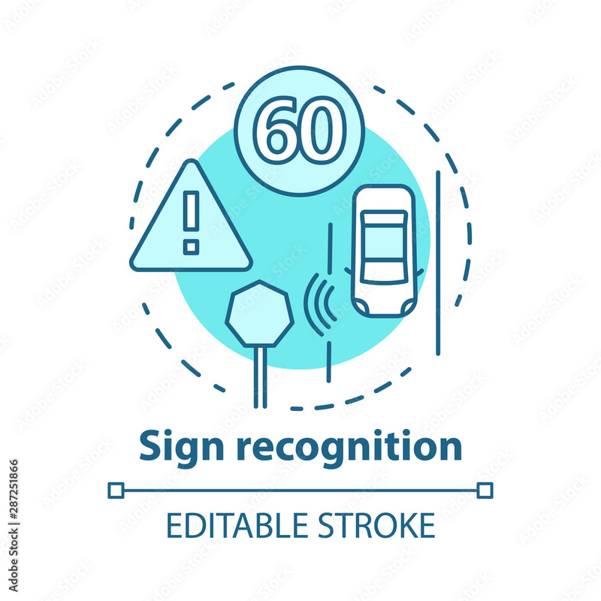
IDEA
SIGNSIGHT - ADVANCED TRAFFIC SIGN RECOGNITION SYSTEM
CUTTING-EDGE TSR TECHNOLOGY IMPLEMENTATION
REAL-TIME CNN FOR TRAFFIC SIGNS
ENHANCING AUTOMOTIVE SAFETY AND NAVIGATION

Slide 4

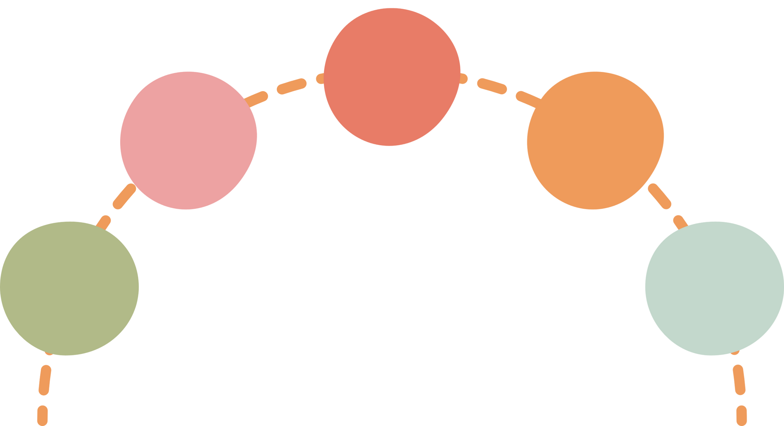
WORKFLOW
PRE-PROCESSING
DATA BALANCING
MODEL BUILDING
MODEL
DEPLOYMENT
DATA CLEANING

Slide 5
CNN ARCHITECTURE
Input shape: (100, 100, 3)
Four sets of convolutional layers:
64 filters, kernel size 3x3, ReLU activation.
128 filters, kernel size 3x3, ReLU activation.
256 filters, kernel size 3x3, ReLU activation.
512 filters, kernel size 3x3, ReLU activation.
Max pooling layers after each convolutional layer:
Pool size: 2x2, Stride:
Flatten layer to convert 2D feature maps into a 1D feature vector.
Fully connected layer with 47 units and softmax activation for classification.

Slide 6
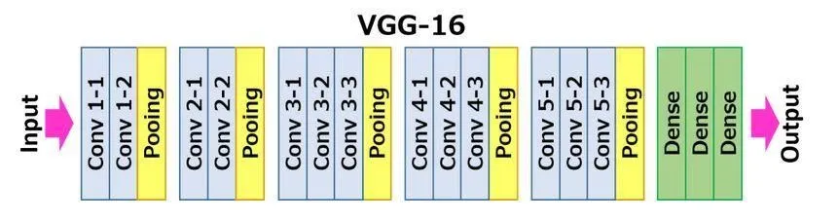
VGG-16 ARCHITECTURE

Slide 7

Evaluation
Model | Accuracy | F1-Score
CNN | 0.99 | 0.99
VGG-16 | 0.858 | 0.85
CNN with PCA | 0.99 | 1
VGG with PCA | 0.98 | 0.98

Slide 8
LIVE DEMO
Website: Project Site

Slide 9
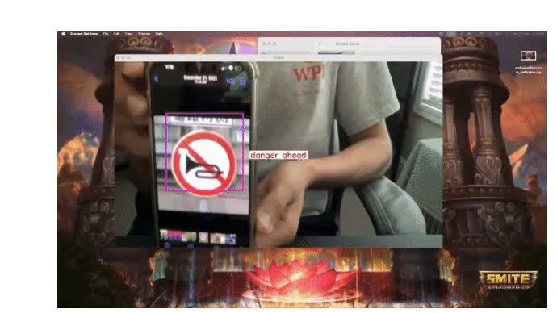
Future Scope
Real Time Object Detection
Multimodal Integration
Adaptive and Context-aware System
Human-Machine Interaction

Slide 10
QUESTIONS

